Slide 1
Systems’ Complexity (II)
Chap 1.3, 1.4, 1.5

Slide 2
Outline
Coping with Complexity
Computer Systems
Suggested Reading
  Cha 1.3, 1.4, 1.5

Slide 3
Coping with Complexity
Modularity
  Split up system, consider separately
Abstraction
  Interfaces/hiding
    e.g. standard size windows
  Helps avoid propagation of effects
Layering
  Gradually build up capabilities
Hierarchy
  Reduce connections
  Divide-and-conquer

Slide 4
Modularity
Analyze or design the system as a collection of interacting subsystems
  Subsystems called modules
  Divide-and-conquer technique
  The simplest, most important tool for reducing complexity
Be able to consider interactions among the components within a module
  Without simultaneously thinking about the components that are inside other modules

Slide 5
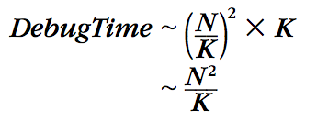
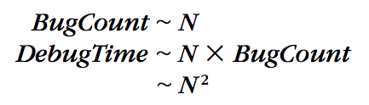
Modularity
Example debugging, but not only debugging
  Bugs are randomly distributed
  Number of bugs is proportional to its size ( λN)
  One Debugging time is proportional to # of statements(κ N)
Original
With Modularity

Slide 6
Modularity
Bug
Bug
Bug
Bug
Original System
System with Modularity

Slide 7
The Unyielding Foundations Rule
It is easier to change a module than to change the modularity
Changing the interface requires replacing at least two modules
  Once an interface has been used by another module
If an interface is used by many modules
  Changing it requires replacing all of those modules simultaneously
It is particularly important to get the modularity right

Slide 8
Abstraction
Abstraction
  Treat a module based on external specifications, no need for details inside
Principles to divide a module
  Follow natural or effective boundaries
  Fewer interactions among modules (Chap.4 & 5)
  Less propagation of effects

Slide 9
Abstraction
Examples
  DVD players
  Registers (circuits to remember states )
  procedure call
  Applications with windows interfaces
    Games, Spreadsheet, Web browsers

Slide 10
Abstraction --- defeated
Minimizing interconnections among modules may be defeated by
  unintentional or accidental interconnections, arising from implementation errors
  well-meaning design attempts to sneak past modular boundaries
    To Improve performance
    To Meet some other requirement

Slide 11
Abstraction --- defeated
Software is particularly subject to this problem
  The modular boundaries
  Provided by the separately compiled subprograms
  are actually somewhat soft
  easily penetrated by errors in
    using pointers
    filling buffers
    calculating array indices

Slide 12
Abstraction
System designers prefer techniques (chp4 ,chap5)
  enforce modularity by
    interposing impenetrable walls between modules
  assure that there can be no
    unintentional or hidden interconnections

Slide 13
Abstraction
Failure
  A module does not meet its abstract interface specifications
Limiting the impact of faults
  Well-designed and properly enforced modular abstractions
    control propagation of effects
Modules are the units of fault containment

Slide 14
The Robustness Principle
Be tolerant of inputs and strict on outputs
Suppress noise or errors
  not propagate or amplify them

Slide 15
The Robustness Principle
A module should accept its input
  If it is still apparent how to sensibly interpret them
  Even if they are not within specified ranges
A module should construct its outputs
  Conservatively(保守) in accordance with its specification
  Making them even more accurate or more constrained than the specification requires if possible
  Not propagate or amplify noise or errors

Slide 16
The Robustness Principle
Role in mass production ---- fitting
  Rifles in 1822; Model T automobile
  In mass production there no fitters
Robustness plays a major role in computer systems
  Human interfaces; Network protocols; Fault tolerance
  It forms the basis for digital logic

Slide 17
The Safety Margin Principle
Keep track of the distance to the cliff, or you may fall over the edge
Abnormal inputs indicate something is going wrong
Track and report out-of-tolerance（超出公差） inputs
  Shake-out mode --- check the input carefully, refuse any wrong input ( even a little error)
  production mode --- accept any input acceptable

Slide 18
Layering
Goal
  Reduce module interconnections even more
How to do it
  Build a set of mechanisms first(a lower layer)
  Use them to create a different complete set of mechanisms (an upper layer)
General rule: A module in one layer only interacts with
  its peers in the same layer
  modules in the next lower layer / next higher layer

Slide 19
Layering
Application layer
OS layer
Processor & memory layer
Memory cells & gates layer
House:
  Inner layer of studs, joist, rafter (shape & strength )
  Layer of sheathing and drywall (wind out)
  Layer of siding, flooring and roof tiles (watertight)
  Cosmetic layer of paint (looks good)
Algebra:
  integer, rationals, complex number, polynomials, polynomials with polynomial coefficients
Notes:
Reduce module interconnections even more
Modules interact in the same/next lower/next higher layer
Build new layers on lower layers

Slide 20
Hierarchy
Hierarchy: another module organization
  Start with a small group of modules
  Assemble them into a stable, self-contained subsystem with well defined interface
  Assemble a group of subsystems to a larger subsystem
Example
  1 manager leads N employees
  1 higher manager leads N lower managers

Slide 21
Hierarchy
There are many striking examples of hierarchy
  from microscopic（显微镜的） biological systems
  to the assembly of Alexander’s empire
  Offers compelling arguments
    under evolution, hierarchical designs have a better chance of survival
Constrains interactions
  permitting them only among the components of a subsystem
reduces the number of potential interactions among modules from square-law to linear
  (n/10) * (9*10) + n/100 *(10)
  lowest layer higher layer

Slide 22
Names make connections
How to connect modules?
In digital systems, the primary method
  One module names another that it intends to use
Why naming
  Postponing of decisions (name a feature , not implementing it )
  Replaceability of modules
  Sharing of modules
Software uses names in an obvious way
Hardware modules connected to a bus
  use bus addresses (a kind of name) for interconnection
Notes:
Any problem in a computer system can be solved by adding a layer of indirection.
Any computer system can be made faster by removing a layer of indirection.

Slide 23
Decouple Modules with Indirection
Indirection supports replaceability
“Any problem in a computer system can be solved by adding a layer of indirection”
  A folk wisdom by David Wheeler (the University of Cambridge)
A computer system can be made faster by removing a layer of indirection
  plausible counterpart of the above folk wisdom
Notes:
Any problem in a computer system can be solved by adding a layer of indirection.
Any computer system can be made faster by removing a layer of indirection.

Slide 24
Naming
When a module has a name
  other modules can use it by name
  thereby sharing
    the design effort
    cost
    information contained in the first module
Names are a cornerstone（基石） element of modularity in digital systems
Notes:
Any problem in a computer system can be solved by adding a layer of indirection.
Any computer system can be made faster by removing a layer of indirection.

Slide 25
1.4
Computer Systems are
Different

Slide 26
Computer Systems are Different
Computer systems are the same as all other systems (plausible)
  Certain common problems show up in all complex systems
  The techniques that have been devised for coping with complexity are universal
Computer systems are different
  The complexity is not limited by physical laws
  The rate of change of technology is unprecedented（空前的）

Slide 27
Unbounded Composition
Two properties of computer systems
  mostly digital
  controlled by software
Separately lead to relaxations of
  limits on complexity arising from physical laws in other systems
Analog systems
  each component contributes noise

Slide 28
Analog Systems
Noise may come from
  the environment
  Component’s physical behavior does not precisely follow any tractable model of operation
Compose analog components
  the noise from individual ones accumulates
  noise may accumulate slowly, but still accumulates

Slide 29
Analog Systems
Noise will dominate the behavior of the system
  As the number of components increases
Noise provides a limit on the number of …
  of analog components that a designer can usefully compose or
  of stages that a designer can usefully cascade

Slide 30
Digital Systems
Digital systems are noise-free
  complexity can grow without any constraint of a bound arising from noise
Use the robustness principle
  the static discipline ,
  the primary source of the magic
  The range of analog values that a device accepts be wider than the range of analog values that the device puts out
    the digital value is ONE or ZERO

Slide 31
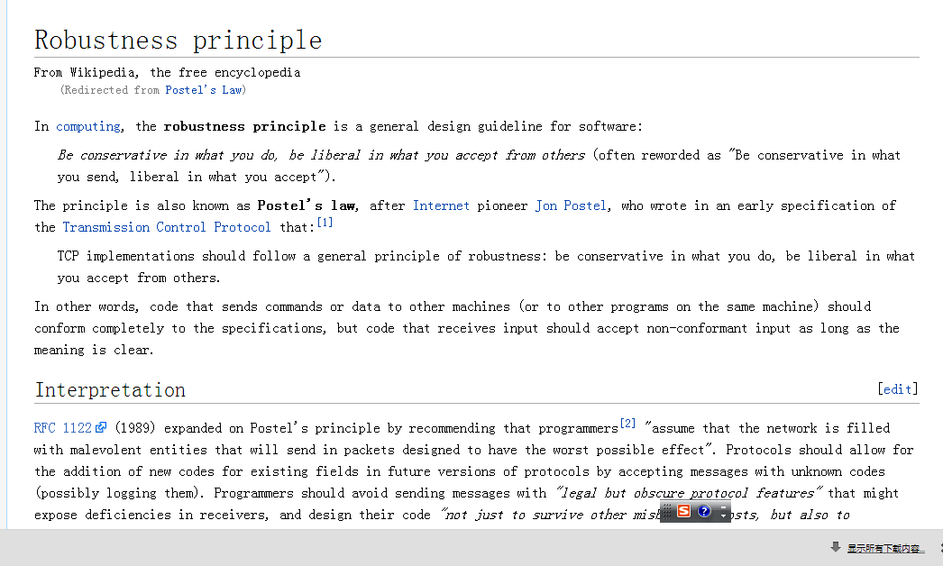
Robustness principle

Slide 32
Digital Systems
Digital systems are constructed of analog components
  The analog components chosen for this purpose are non-linear
  components have gain between input and output
  Non-linearity allows inputs to have a wide tolerance figure 1.3
  Gain assures that outputs stay within narrow specifications

Slide 33
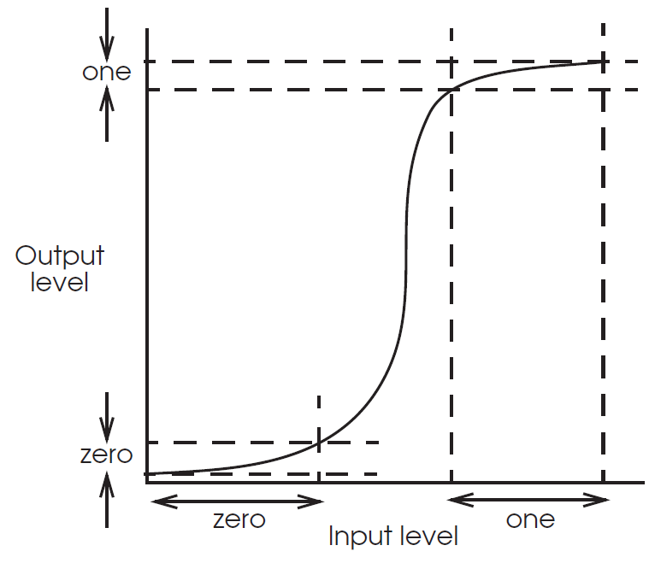
Digital Systems
  figure 1.3

Slide 34
Digital Systems
“level restoration（复位）” or “regeneration”
  appear at the output of every digital component
  create clean interfaces
    allow one subsystem to be connected to the next with confidence
Level restoration do not guarantee
  Devices with digital inputs and outputs never make mistakes
component fail ？
  digital components only make big mistakes
    relatively easy to detect and correct

Slide 35
Digital Systems
A signal does not accumulate noise as it goes through a string of devices
  then noise does not limit the number of devices one can string together
  noise does not constrain the maximum depth of composition for digital systems
Digital systems can grow in complexity
  until they exceed the ability of their designers to understand them
    Modern processor chips contain upwards of 40 million transistors
    No airliner has nearly that many components

Slide 36
Computer systems are Controlled by Software
even worse to the complexity
Hardware is subject to some physical limits
  the speed of light
  the rate of settling of signals in real semiconductor materials
  unwanted electrical coupling between adjacent components
  the rate at which heat can be removed
  the space that it occupies
Software has no physical limits
  Whatever beyond the availability of memory to store it and processors to execute it

Slide 37
Problem of abstractions
Most abstractions don’t perfectly conceal the underlying implementation in reality
  slightly “leaky,”
Leakiness accumulates as the number of software modules grows
  in the form of complexity (a fundamental problem)
  far beyond the ability of its designers to understand
Example: if addition of integers overflows → surprise → complexity

Slide 38
NO noise accumulation and physical limits
This phenomenon is quite unknown in the design of bridges and airliners.
Misuse the tools of modularity, abstraction, layering, and hierarchy
  Too easy for an unwary designer to do it
  To include still more complexity
It tempts designers to build more complex systems
Computer systems allow composition to a depth
  first limit is the designer’s ability to understand

Slide 39
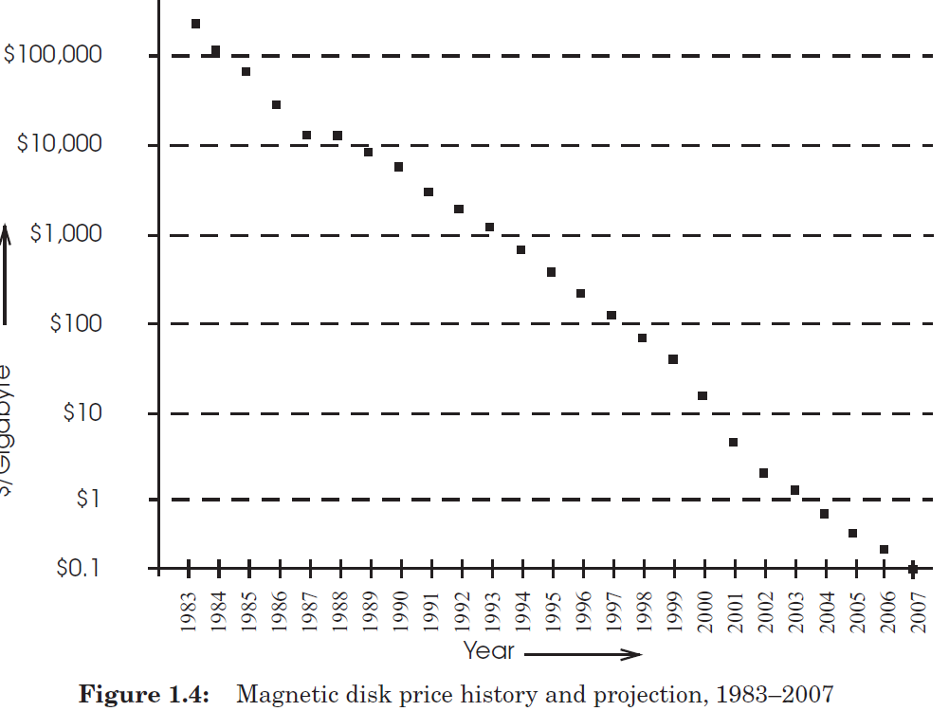
Hardware are cheaper

Slide 40
d(technology)/dt is Unprecedented
d(Technology)/dt = K × Technology
Technology = e^{Kt}
by the time a computer system is ready for delivery
  the ground rules under which it was originally designed have shifted
  Since complex systems can take several years to build
Less emphasis on
  detailed performance analysis and fine-tuning

Slide 41
The Incommensurate Scaling Rule
Changing any system parameter by a factor of 10 usually requires a new design
  When a computer system is being delivered
    It needs two rounds of adjustment and a new design
  It may run an order of magnitude faster
New design may have something completely different from the previous one

Slide 42
d(technology)/dt is Unprecedented
No deep analysis on the previous design→ leave mistakes in old version → complexity
Less emphasis on detailed performance analysis and fine-tuning
  Too soon to adjust or redesign
  Less benefit from studying the previous cases
  Waiting for 4 months can get 20% performance improvement
  Brute force solutions: use more memory, faster CPU

Slide 43
d(technology)/dt is Unprecedented
Ragged usability
  New computer provides new features, or the old features cheaply
Legal and judicial processes take decades to grips with new issues
New technology is very quick to be adopted
Telescoping(压缩) of the usual process
  Planning, examining requirements, tailoring details, integrating with users
  Systems that have rough edges and without the benefit of the cleverest thought

Slide 44
Chap 1.5
Coping with Complexity of Computer Systems
Suggested Reading
  Cha 1.5

Slide 45
coping with complexity
The complexity of computer systems amplified by
  The opportunity to create systems of unimaginable — and unmanageable — complexity
  Designers temps to use new and untested ground rules

Slide 46
Modularity… are not enough
Modularity, abstraction, layering, and hierarchy are not enough
  They assume the designer understands the system being designed
  In the fast-changing world of computer systems
    Hard to choose the right one from a sea of plausible alternatives:

Slide 47
Iteration
Iteration
  Take small steps
  Don’t rush
  Plan for feedback
  Study failures
Obstacle: after iteration losing integrity
  Even the first initial version →accommodate all the iterations , (2) and follow the design rationale
Design for iteration
You won’t get it right the first time, so design it to be easy to change.
Keep digging
Complex systems fail for complex reasons.

Slide 48
Simple
KISS: Keep It Simple, Stupid!
  Adopt sweeping simplifications
    So you can see what you are doing.

Slide 49
Rest of the class
Three recurring themes
  The pervasive importance of modularity
    Goal & cornerstone
  Principle-based system design
    Computer system design is not completely ad hoc
  Making system robust and resilient
    Control propagation of effects

Slide 50
The Big Picture
Consistency
Network
Atomicity
Naming
C/S
Virtualization
Modularity
Fault Tolerance
Abstraction
Layering
Notes:
Modularity is fundamental
Naming: glue of modules
C/S & virtualization are used for enforced modularity
Network, Atomicity and Consistency are based on modularity

